Slide 1
Why Normalization is needed in the Data Processing of Neural Networks
Presented by Subhi Bhuiyan
ID: 17201116 Sec: 02
CSE425 Neural Networks

Slide 2
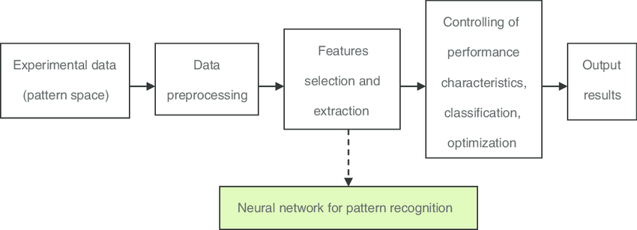
Neural Networks are powerful methods for mapping
unknown relationships in data and making predictions.
Application: Pattern Recognition Problems

Slide 3
Rarely neural networks are applied “directly” to
the raw data of a dataset.
We need a preparation that aims to:
Facilitate the network optimization process
Maximize probability of obtaining good results

Slide 4
Data Processing
Data Processing is the task of converting data from a given form to a much more usable and desired form i.e. making it more meaningful and informative.
automated
structured manner

Slide 5
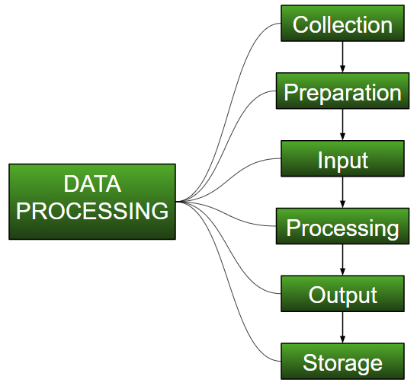
Stages of Data Processing

Slide 6
Data Transformation
Mandatory Transformation
Optional Quality Transformation
Help the model perform better
Data Compatibility
Normalization

Slide 7
What is data normalization?
Data normalization is changing the values of
numeric columns in the dataset to a common scale,
without distorting the differences in the ranges of values or losing information.

Slide 8
Why data normalization?
Some Machine Learning algorithms like Linear Regression,
Logistic Regression, and Neural Networks
require data to be scaled.
Distance algorithms like k-means and SVM are affected
by the range in the feature values.

Slide 9
Normalization
Goal: Transform features to be on a similar scale. Normalizing features so that they use a common scale is a general requirement for many machine learning algorithms.
Improves the performance and training stability
of the model

Slide 10
Which Algorithms require Normalization?
Any machine learning algorithm that computes
the “distance” between the data points. This includes all
curve based algorithms.
Example: 1. KNN (K Nearest Neighbors) 2. SVM (Support Vector Machine) 3. Logistic Regression 4. K-Means Clustering

Slide 11
Normalization Techniques
scaling to a range
clipping
log scaling
z-score

Slide 12
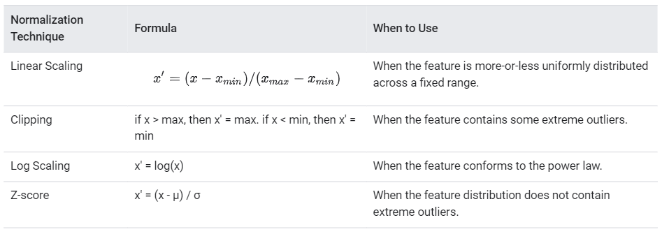

Slide 13
Thank you!

